Slide 1
Section-4 – Personalized Marketing
Chapter 10-Data-Driven Customer Segmentation

Slide 2
Introduction
In marketing, we often try to understand the behavior of certain subgroups of the customer base.
Especially in targeted marketing, marketers try to segment the customer base in certain ways and focus on each target segment or customer group.
This concentration on certain target customer segments results in better performance, as the needs and interests of those customers in the target group align and match better with the business's products, services, or content.
In this chapter, deeper into the concept of customer segmentation.
Will discuss what customer segmentation is, the importance and benefits of having a good understanding of different segments of the customer base, and how to utilize customer segment analysis results for different marketing strategies.

Slide 3
Introduction
In this chapter, will learn how can use the k-means clustering algorithm to build customer segments based on the historical data.
In this chapter, cover the following topics:
Customer segmentation
Clustering algorithms
Segmenting customers with Python
Segmenting customers with R

Slide 4
Customer segmentation
Given today's competition within the market, it is critical to understand the different behaviors, types, and interests of customers.
Especially in targeted marketing, understanding and categorizing customers is an essential step in forming effective marketing strategies.
By segmenting the customer base, marketers can focus on one segment of customers at a time.
It also helps marketers to tailor their marketing messages to one specific audience at a time.
Customer segmentation is the backbone of successful targeted marketing, with which you can target specific groups of customers with different pricing options, promotions, and product placements that capture the interests of the target audience in the most cost-effective way.
Any business or industry can benefit from a better understanding of different customer segments.

Slide 5
Customer segmentation
For example, television advertisements that are broadcast across all over the USA for an outerwear brand that sells winter clothes, such as parkas, snow boots, and hats, would not be so cost-effective.
People residing in areas that never really get cold, such as Florida, Southern California, or Hawaii, would most likely not be interested in purchasing winter clothes.
However, people residing in areas with cold winters, such as Alaska, Minnesota, or North Dakota, would most likely want to buy clothes that will keep them warm.
So, for this outerwear brand, instead of sending out marketing mails or emails to all of their customers, it would be better to target those segments of customers, based on their geographic information, that live in places where they would need winter clothes more frequently than other customers.
As another example, if you own a rental building near a college, you might want to target your customers based on their age and education.
Marketing to customers between 20 and 30 and who are attending surrounding colleges will have higher return than marketing to others.

Slide 6
Customer segmentation
For hotel businesses, you might want to target those couples who have upcoming anniversaries for romantic package deals.
Using social media platforms, such as Facebook or Instagram, you can target this segment of customers.
As discussed with these three cases, understanding your customers and which segment describes them the best can help you develop effective and efficient marketing strategies.
When segmenting the customer base into subgroups, you can use certain characteristics and their statistics, as shown in Chapter 7, Exploratory Analysis for Customer Behavior.
However, when you are trying to segment your customers with multiple attributes, it becomes exponentially more difficult.
In the following sections, discuss how to use machine learning for customer segmentation.

Slide 7
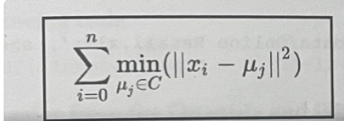
Clustering algorithms
Clustering algorithms are frequently used in marketing for customer segmentation.
This is a method of unsupervised learning that learns the commonalities between groups from data.
Unlike supervised learning, where there is a target and a labeled variable that to predict, unsupervised learning learns from data without any target or labeled variable.
Among numerous other clustering algorithms, explore the usage of the k-means clustering algorithm in this chapter.
The k-means clustering algorithm splits the records in the data into a pre-defined number of clusters, where the data points within each cluster are close to each other.
In order to group similar records together, the k-means clustering algorithm tries to find the centroids, which are the centers or means of clusters, to minimize the distances between the data points and the centroids within the clusters.
The objective equation

Slide 8
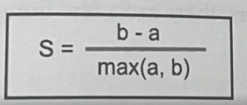
Clustering algorithms
Here n is the number of records in the dataset, x, is the ith data point, C is the number of clusters, and µj is the jth centroid.
One downside or difficulty of using k-means clustering for customer segmentation is the fact that need to know the number of clusters beforehand.
However, quite often, do not know what is the optimal number of clusters to create.
The silhouette coefficient can be used to evaluate and help to make decisions on what the best number of clusters will be for segmentation problem.
Simply put, the silhouette coefficient measures how close the data points are to their clusters compared to other clusters.
The equation is shown here:

Slide 9
Clustering algorithms
Here b is the average of the distance between a point and its closest cluster and a is the average distance among data points within the same cluster.
The silhouette coefficient value ranges from -1 to 1, where the closer the values are to 1, the better they are.
In the following programming exercises, segmenting the customer base from our dataset, using the k-means clustering algorithm and the silhouette coefficient.

Slide 10
Segmenting customers with Python
In this section, discuss how to segment the customer base into subgroups using the clustering algorithm in Python.
Mainly using the pandas, matplotlib, and scikit-learn packages to analyze, visualize, and build machine learning models.
For this exercise, using one of the publicly available dataset “OnlineRetail” from the UCI Machine Learning Repository.
Once downloaded this data, load it into your Jupyter Notebook by running the following command:
import pandas as pa
df = pd. read_excel ('../data/Online Retail.xlsx', sheet_name='OnlineRetail')

Slide 11
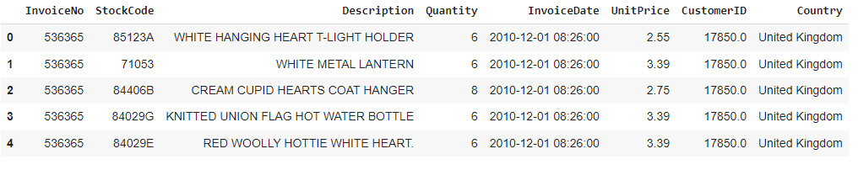
Segmenting customers with Python
The DataFrame, df, looks like this:

Slide 12
Data cleanup
Before start building clustering models, there are five tasks to do to clean up our data and prepare it for modeling.
The clean-up steps are as follows:
1. Dropping canceled orders: drop records with negative Quantity, using the following code:
df = df. loc[df ['Quantity'] › 0]
2. Dropping records with no Customer ID: There are 133, 361 records with no Customer ID and we are going to drop those records with the following code:
df = df [pd.notnull (df [' CustomerID' ])]
3. Excluding an incomplete month: The data in the month of December, 2011, is incomplete. exclude this data with the following code:
df = df. loc[df[' InvoiceDate '] < '2011-12-01']

Slide 13
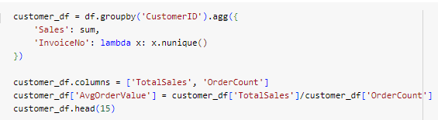
Data cleanup
4. Computing total sales from the Quantity and UnitPrice columns: For our analyses, we need the total sales value, so we are going to multiply the two Quantity and UnitPrice columns, to get the total sales, as shown in the following code:
df ['Sales'] = df ['Quantity'] * dfl 'UnitPrice']
5. Per-customer data: In order to analyze customer segments, transform our data, so that each record represents the purchase history of individual customers. Take a look at the following code:

Slide 14
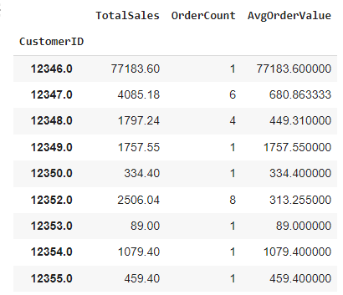
Data cleanup
From this code, grouping the DataFrame, df, by Customer ID and computing the total sales and the number of orders for each customer.
Then, also calculate the average per-order value, AvgOrderValue, by dividing the TotalSales column by the OrderCount column.
The result is shown in the following screenshot:

Slide 15
Data cleanup
Now, from this data, the three columns, TotalSales, OrderCount, and AvgOrderValue, have different scales.
TotalSales can take any values from 0 to 77,183, while OrderCount takes values between 1 and 201.
Clustering algorithms are highly affected by the scales of the data, so normalize this data to be on the same scale.
Take two steps to normalize this data.
First, we are going to rank the data, so that the values of each column range from 1 to 4298, which is the total number of records.
Take a look at the following code:
rank_af = customer_df. rank (method=' first')

Slide 16
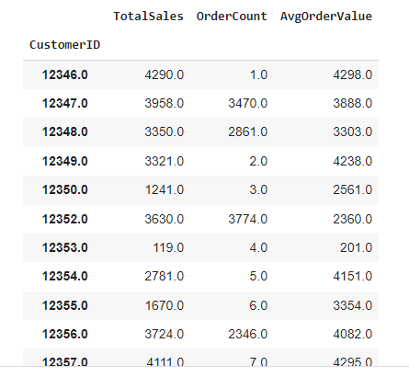
Data cleanup

Slide 17
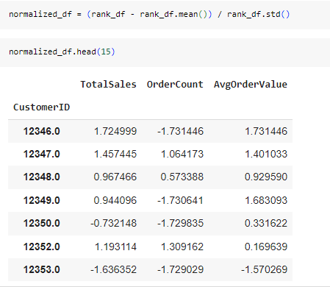
Data cleanup
Next normalize this data to center around the mean and have a mean of 0 and a standard deviation of 1.

Slide 18
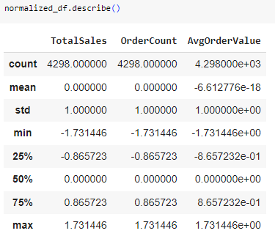
Data cleanup
To look at the statistics of each of these columns, Shown the following screenshot:
The values are centered around at 0 and have a standard deviation of 1.

Slide 19
k-means clustering
The k-means clustering algorithm is a frequently used algorithm for drawing insights into the formations and separations within data.
In marketing, it is often used to build customer segments and understand the behaviors of these different segments.
In order to use the k-means clustering algorithm in the scikit-learn package, import the kmeans module, as shown in the following code:
from sklearn.Cluster import KMeans
Then, build and fit a k-means clustering model, using the following code:
kmeans = KMeans (n_clusters=4) . fit (normalized_df [['TotalSales','OrderCount', 'AvgOrderValue ' ]] )

Slide 20
k-means clustering
From this code, building a clustering model that splits the data into four segments.
You can change the desired number of clusters with the n_clusters parameter.
Using the fit function, train a k-means clustering algorithm to learn to split the given data.
In this code, building four clusters, based on the TotalSales, OrderCount, and AvgOrderValue values.
The trained model object, kmeans, stores the labels and centers of the clusters in the labels_ and cluster_centers_ attributes of the model object.
Retrieve these values as shown in the following code:
kmeans. labels_
kmeans. cluster_centers_
Now that we have built our first clustering model, let's visualize this data.
First, take a look at the following code:

Slide 21
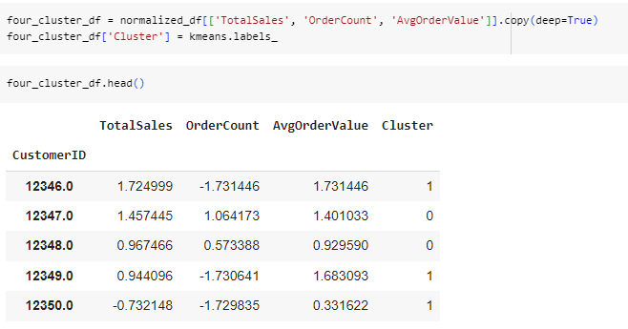
k-means clustering

Slide 22
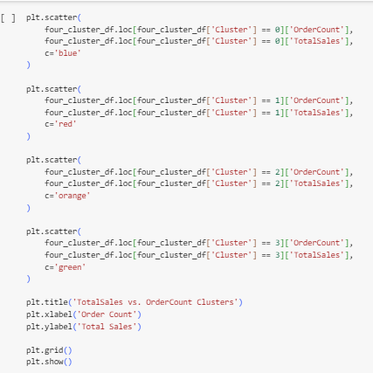
k-means clustering
Store the cluster label information for each record into a newly created DataFrame, four cluster_df.
With this DataFrame, visualize the clusters, using the following code:

Slide 23
k-means clustering
The cluster in blue is the group of low-value customers, who have not purchased our products so much.
On the other hand, the cluster in red is the group of high-value customers, who have purchased the greatest amount and who have purchased products frequently.
Also visualize the clusters with different angles, using the rest of the variables.
The first plot shows the clusters visualized based on AvgOrderValue and OrderCount.
On the other hand, the second plot shows the clusters visualized based on AvgOrderValue and TotalSales.
From these plots, the cluster in blue has the lowest average per-order value and the lowest number of orders.
However, the cluster in red has the highest average per-order value and the greatest number of orders.
Visualizing clusters helps you understand the characteristics of different clusters much more easily and clearly.

Slide 24
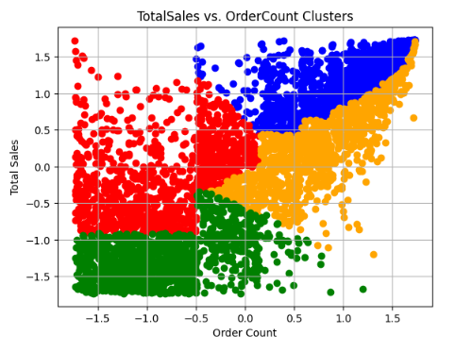
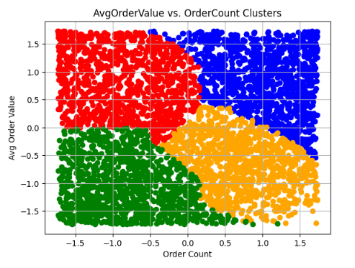
k-means clustering

Slide 25
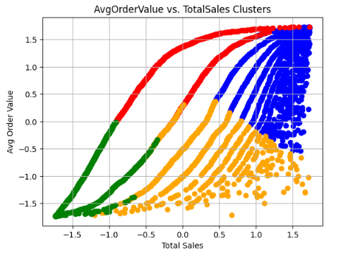
k-means clustering

Slide 26
Selecting the best number of clusters
Often, do not know what the best number of clusters to use is when building k-means clustering models.
As discussed in an earlier section of this chapter, we can use the silhouette coefficient to determine what the best number of clusters is to split the data.
In the scikit-learn package, use the silhouette_score function in the sklearn.metrics module to calculate the silhouette score and measure the quality of clusters.
From the below code, experimenting with five different numbers of clusters: 4, 5, 6, 7, and 8.
For each amount of clusters, measure the silhouette score and choose the amount of clusters with the highest score.
The output of this code looks like this:

Slide 27
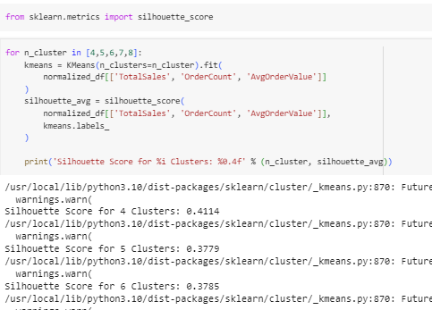
Selecting the best number of clusters
In our case, of the five different numbers of clusters experimented with, the best number of clusters with the highest silhouette score was 4.
In the following section, we will use 4 as the number of clusters to show how to interpret the results of the clustering analysis.

Slide 28
Interpreting customer segments
In this section, discuss different ways to draw insights from the results of the previous clustering analysis.
Let's first build a k-means clustering model with four clusters.
Use the following code:
From the below code, fitting a k-means clustering model with 4 clusters, based on three attributes: TotalSales, OrderCount, and AvgOrderValue.
Then, store the cluster label information into a DataFrame, four_cluster_df.
This DataFrame is shown in the following screenshot:

Slide 29
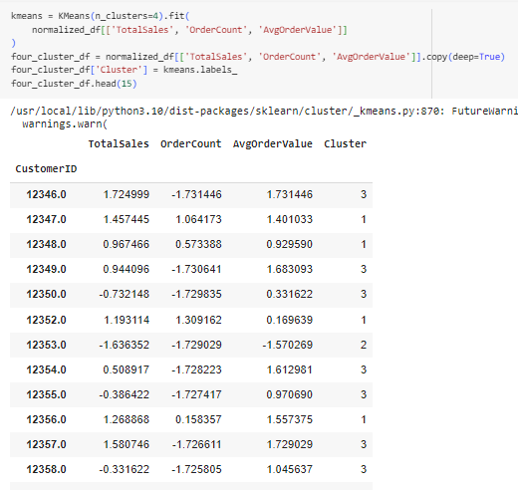
Interpreting customer segments

Slide 30

Interpreting customer segments
The first thing going to look at is the centers of each cluster.
Get the cluster centers using the following code: kmeans.cluster_centers_
The output of this code is shown in the following screenshot:
The fourth cluster has the lowest numbers for all three attributes.
This suggests that the fourth cluster contains customers with the smallest amount of sales, smallest number of orders, and lowest average per-order value.
This group of customers is one of low-value customers.
On the other hand, the third cluster has the highest numbers for all three attributes.
The customers in the third cluster have the greatest amount of sales, greatest number of orders, and highest average per-order value.
So, these customers in the third cluster purchase expensive items and give the business the highest revenue.
You would typically want to focus your marketing efforts on this segment of customers, as it will result in the highest return.

Slide 31
Interpreting customer segments
The customers in the second cluster are interesting.
They make purchases relatively frequently, as they have a medium-to-high cluster center value for OrderCount, but their average per-order value is low, as the cluster center for AvgOrderValue is low.
These are the customers who make frequent purchases of low-value items. So, it would be perfect to market items with low per-item prices to this segment of customers.
The customers in the first cluster are also interesting.
Their contributions to the revenue and number of orders are medium to low, looking at the centers of this cluster.
However, their average per-order value is high.
These are the customers who buy expensive items infrequently.
Thus, it would be perfect to market expensive items to this segment of customers.
As you can see from this example, looking at the centers of clusters helps us understand different types and segments of customers and how to target them differently.
Lastly, we can also find out what the best-selling items are for each customer segment.

Slide 32
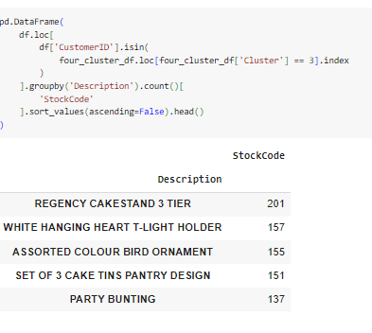
Interpreting customer segments
Take a look at the following code:
Utilize this information in marketing strategies, when you target this customer segment.
In your marketing campaigns, you can recommend items similar to these best-selling items to this segment of customers, as they are the most interested in these types of items.

Slide 33
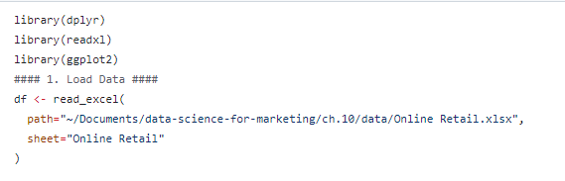
Segmenting customers with R

Slide 34
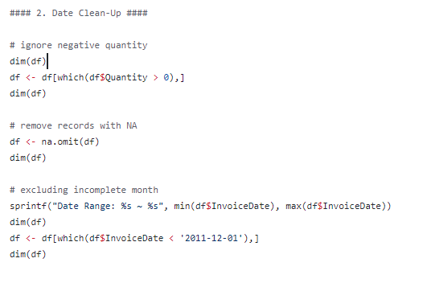
Data Cleanup

Slide 35
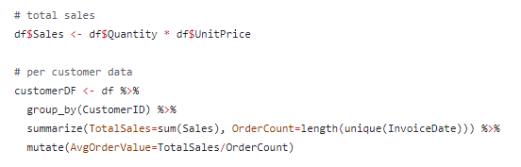
Data Cleanup

Slide 36
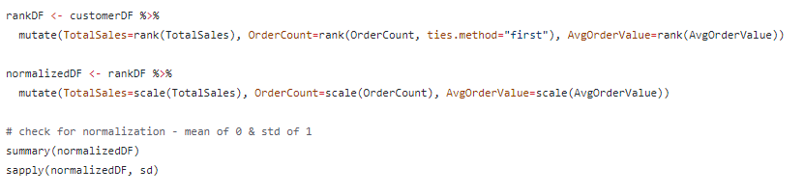
Data Cleanup

Slide 37
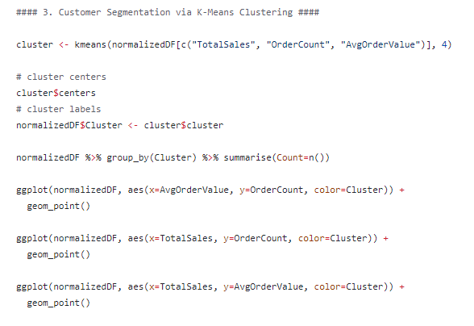
Customer Segmentation – K_means clustering

Slide 38
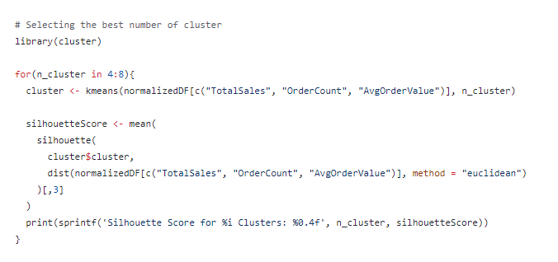
Customer Segmentation – K_means clustering

Slide 39
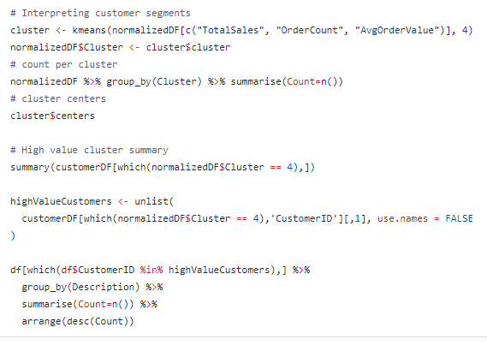
Interpreting Customer Segments

